Slide 1

spark Core
Notes:
We need fine grained mechanism of processing of data and deal with unstructured data
More detail customized solution
We saw previously with pig ,sqoop and Hive we can do structure and semi structure data .Spark can be used for unstructured data
Spark as two component : framework which we can do anything and also provide execution engine
Whatever you can do in Hadoop you can do it in spark even more
Spark is like a super set of all of this
Hadoop has lack of tools for streaming data or unstructured data (Flume is there but it has its own disadvantages)
So Spark can Ingest stream data and batch data Whatever Hadoop it will provide even more
On top of that spark provides execution engine like map reduce
Apache Tez IS GOOD FOR PIG ,HIVE But if you want to write your programs like spark program Tez WILL NOT THAT GOOD when it come to spark
The moment you want fined grained control or you want your custom logic then spark execution engine comes which tries to load it to memory as much as possible
.Tez is good for Hive and Pig

Slide 2
Spark Framework – RDD (Resilient Distributed Dataset)
Distributed dataset
Partitioned
Unit of processing in Spark
rdd is a dataset which is being proceed
Partition –distribute –process
Notes:
In the heart of spark frame work is called spark RDD
Resilient DISTRIBUTED DATASET
YOUR DATASET WILL BE DISTRIBUTED TO all nodes across the cluster and process in parallel
Data is partitions for example 100 partition then distributed across node then will process
Partition –distribute –process
So rdd is Unit of processing in Spark
It is resilience in nature

Slide 3
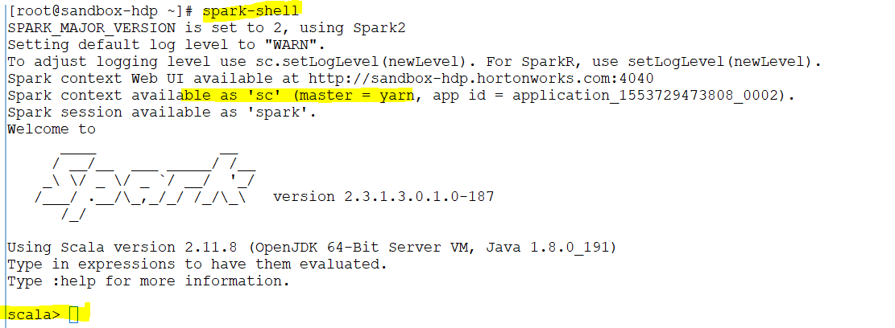
Notes:
When I run this command it will create single node cluster .it tries to 2 node cluster with each node is essentially a threat .as we have two core it will simulate 2 nodes cluster
Master =Yarn .it tries to simulate the cluster out of the local machine
Where each node is a threat
As this machine has 2 cores so it will simulate it to two nodes.

Slide 4
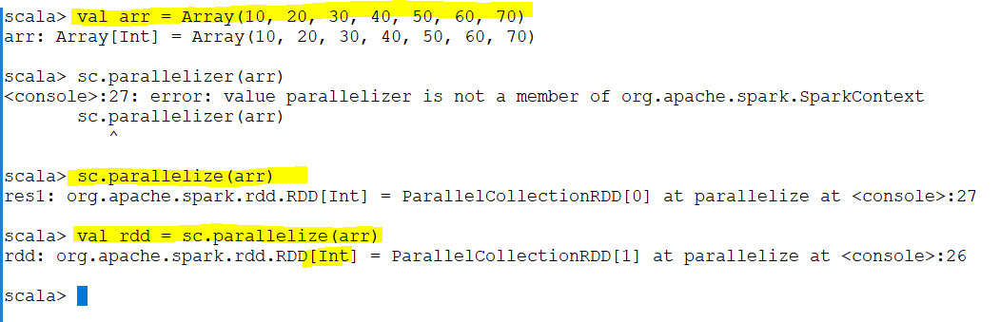
Notes:
Spark context is the heart of the spark
It’s a handle to spark cluster
Spark has parallelize the collections to 2 nodes
these 7 values have been partitioned and distributed across these two nodes
10 goes to partition 1
20 goes to partition 2
30 goes to partition 1
40 goes to partition 2
…….
Distribute :
10 to first node
20 to the second
to first node
to the second
Rdd is essentially a dataset which is being process .First case it was array (10 ,20 ….) was dataset
Rdd will partition it and distribute it across all nodes

Slide 5
Parallelized Collection
A collection created in the driver program can be distributed amongst worker nodes to be executed in parallel. Note that, in practice, this mechanism is rarely used. Also, it has the disadvantage of shuffling of data from the driver to the nodes in a distributed environment.
Option 1
val arr = Array(20, 35, 28, 36, 73, 85)
sc.parallelize(arr)
Option 2
val arr = = Array(20, 35, 28, 36, 73, 85)
sc.parallelize(arr, num_partitions)

Slide 6
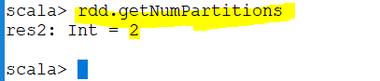
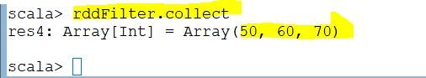
Notes:
As I have assigned two cores it will shows 2 as number of partitions
Element is what we receive if filter return true then rddFilter will contain that element .if filter returns false then rddFilter will not contain that element
For example 10 is less than 40 and it will not be in the rdd Filter however 50 is grater than 40 and it will be in the rddfilter

Slide 7
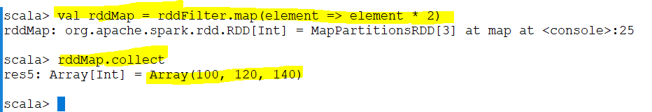
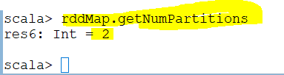
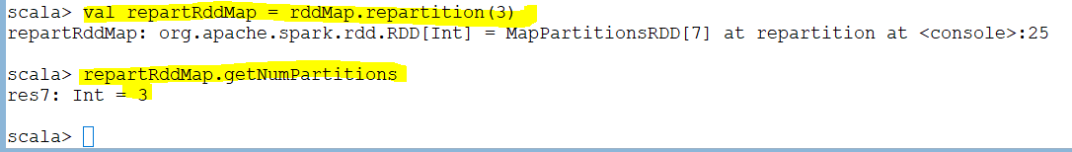
partition 1 has 100 records - 1 minute
partition 2 has 5 records - 5 second
partition 3 has 0 records - (one CPU core and some memory are allocated)
partition 4 has 50 records - 30 second
Node 1 -50 30 second
Node 2 – 50 30 second
Node 3 – 55 30 second
Notes:
Operation Map
We saw in scala
We map each value to different value
Even the rdd has more elements it still has 2 nodes to process
So its in insufficient to have three elements in to partitions so we can reparation it
The reason for repartitioning data is avoid have skewed data .In this case is skewed partition
Some partition has more values
Assume we have 4 partition .
partition 1 has 100 records
partition 2 has 5 records
partition 3 has 0 records
partition 4 has 50 records
This is extremely skewed.
Problem : we do not need to have a task for partition 3 because we are losing resource for something we does not have record.
Moreover is insuffient to do it 5 records in partition 2 we can move it to another partition .Thats why repartitioning is very important.
When we do repartition to three spark see that as 100+5+50 records = 155 records
Node 1 -100 1 minutes
Node 2 – 5 5 se
Node 3 – 0 (one cpu core and some memory are allocated)
Node 4 -50 30 se
(All the jobs has to wait till everyone finish .even they finish early)
So it will change it to
Node 1 -50 30 second
Node 2 – 50 30 second
Node 3 – 55 30 second
Its not guarantee to have node 1s 50 it might be 45 or node 3 as 45
We partition to make it more efficient .

Slide 8
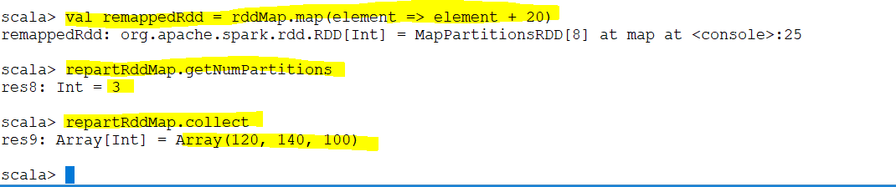
Notes:
When we run this code this code “rddMap.map(element => element + 20)” will move to the partition and this code become a task in that partition.
Another task will be created for 120 and it will run the code for that partition
Then Another task will be created for 140 and it will run the code for that partition.

Slide 9
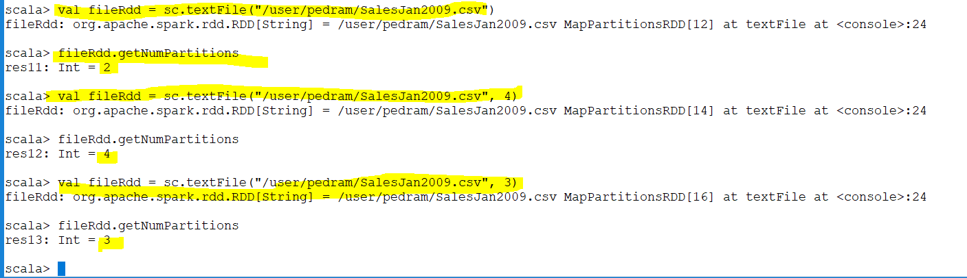
Notes:
Every spark program has two components :Driver , the set of executer or worker nodes
1. Driver
2. Set of executors or worker nodes
Driver is where your main program runs .Every spark program has main
The ex are the machine which always our task runs
In this case we have 4 partition or 4 executer (probably) sc.textFile("/user/pedram/SalesJan2009.csv", 4) .we have mentioned explicitly that we need four partitions
When we run textfile command ,driver will ask executer to actually load partial of the data in to the memory .
=========================================================
Assume we use the following and our data has 8 blocks
sc.textFile("/user/pedram/SalesJan2009.csv, 4“)
This file has 8 blocks in hdfs so it will loads 2 blocks in executer 1 and 2 blocks in executer 2 ,…
Each block become one partition . Each executer have two partition .

Slide 10
Load Files
In practice, data is loaded from an actual source like a file system (HDFS, S3, local file system etc.) or a streaming data source like Kafka or Amazon Kinesis.
val file = sc.textFile(file_path)
val file = sc.textFile(file_path, num_partitions)
Notes:
If using a path on the local file system, the file must also be accessible at the same path on worker nodes.
All of Spark’s file-based input methods support running on directories, compressed files, and wildcards as well.
The textFile method also takes an optional second argument for controlling the number of partitions of the file. By default, Spark creates one partition for each block of the file, but you can also ask for a higher number of partitions by passing a larger value. However, you cannot have fewer partitions than blocks.
Notes:
If using a path on the local filesystem, the file must also be accessible at the same path on worker nodes.
Why ?
When we run “sc.textFile("/user/pedram/SalesJan2009.csv, 4“)” driver will move this code to each executer which is a different node or machine in the cluster
While running the program or driver this code will move to other 4 machines .When It goes to each four machines each of them have their own file system .if it is hdfs no problem because there is only one file name but
If it is local then this path ("/user/pedram/SalesJan2009.csv, 4“)” may not be valid for that node. It means the file should be presented in this node.
2 distinction
===========
When we load an hdfs file each block become a partition in an executer while
When we load from local file system a copy of the same file will copy to each executer .each file become a partition unless we mention 4 in “sc.textFile("/user/pedram/SalesJan2009.csv, 4“)”
where each file become 4 partitions
So val fileRdd = “sc.textFile("/user/pedram/SalesJan2009.csv, 4“)” four copies in each executers .so the files need to be splitted. paste on each executer .then this statement needs to be executed “val fileRdd = “sc.textFile("/user/pedram/SalesJan2009.csv, 4“)” otherwise if we copy the same file with same contents so data will be duplicated (for example in this case is 4 duplication)

Slide 11
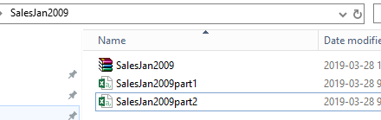
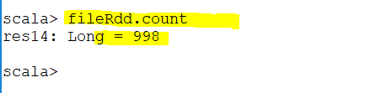
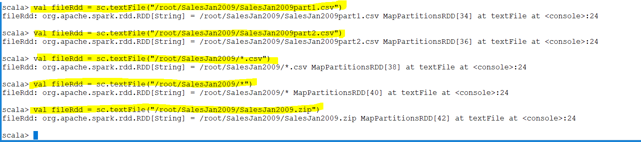
Notes:
Even your file is compressed but its text file still can be loaded .

Slide 12
Whole Text Files
sc.wholeTextFiles lets you read a directory containing multiple small text files, and returns each of them as (filename, content) pairs. This is in contrast with textFile, which would return one record per line in each file. Partitioning is determined by data locality which, in some cases, may result in too few partitions. wholeTextFiles provides an optional second argument for controlling the minimal number of partitions.
Notes:
Sc.textfile will load the csv file and make each line in csv file a record in RDD.1st line become 1st record.2nd line become 2nd record ,…Any time you are doing an operation you are doing line by line operation.
There might be a situation that you might need a file name as well. There might be a situation that I need a file name
Whenever I use sc.textfile (“…”) read the file it will create one single RDD whether each line in that file become a record in rdd. It does not distinguish between file. What about if I want to provide a file name
Spark use wholetextfile

Slide 13
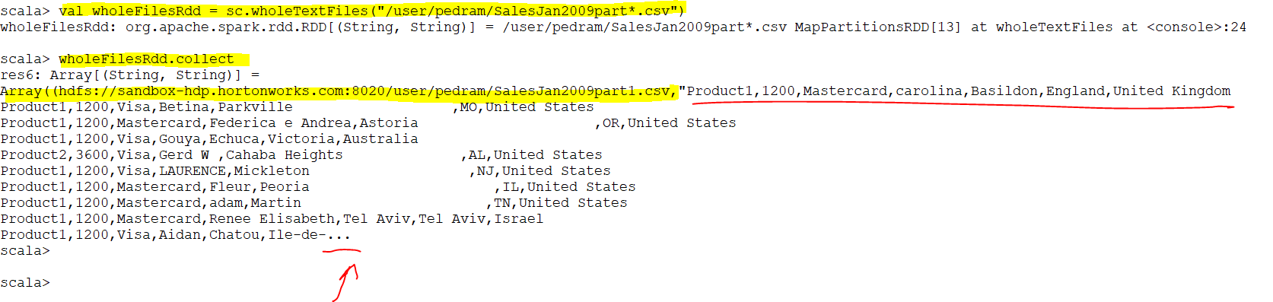
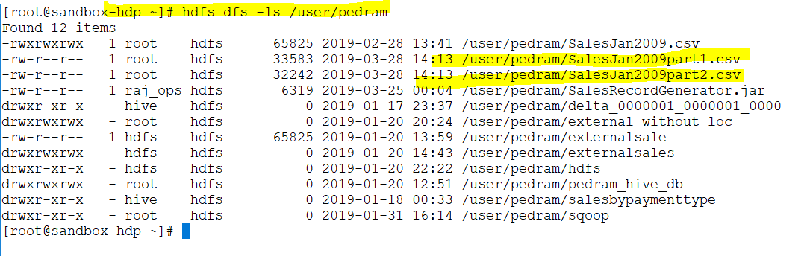
Notes:
So it shows the name of the first part and its contents then the second file name with path and their contents but it has only shown “…”
There are two file in hdfs which matches SalesJan2009Part*
When we need the file name of the record its better to load as wholefile.
As you can see it returns a tuple in which the first item is the location and file name and the second item is the contents of the file)
The issue with that is if I am using large file then that might become an issue because it can not load it in the memory so it applies for small files and when we need the name of the file while we processing it.

Slide 14
Loading other file types
sc.sequenceFile is used to load sequence files
sc.hadoopRDD is used for other file types
sc.newAPIHadoopRDD can also be used
*Refer to scaladoc for details

Slide 15
PairRDD Transformations
filter(func)
map(func)
flatMap(func)
union(otherDataset)
intersection(otherDataset)
distinct([numPartitions]))
groupByKey([numPartitions])
reduceByKey(func, [numPartitions])
sortByKey([ascending], [numPartitions])
join(otherDataset, [numPartitions])
coalesce(numPartitions)
repartition(numPartitions)
repartitionAndSortWithinPartitions(partitioner)
Its called pairRdd because it returns a Tuple. The first element of the tuple is a key and the second element is value
Notes:
In Rdd we have line which is a record.
InThis called pairRdd BECAUSE IT RETURNS A Tuple. The first element of the tuple is a key and the second element is value
pair Rdd we have key and a value like wholetextvalue .the key is file name and the value is the entire content of the file

Slide 16
RDD Transformations
filter(func)
map(func)
flatMap(func)
union(otherDataset)
intersection(otherDataset)
distinct([numPartitions]))
coalesce(numPartitions)
repartition(numPartitions)
repartitionAndSortWithinPartitions(partitioner) [*Only available for JavaPiarRdd]
Notes:
Coalesce : it remove redundant partition .
That is the difference between Coalesce and repartition is in repartition you can increase the repartition but in Coalesce you can reduce the number of partition .
In our case remove all redundant partition

Slide 17
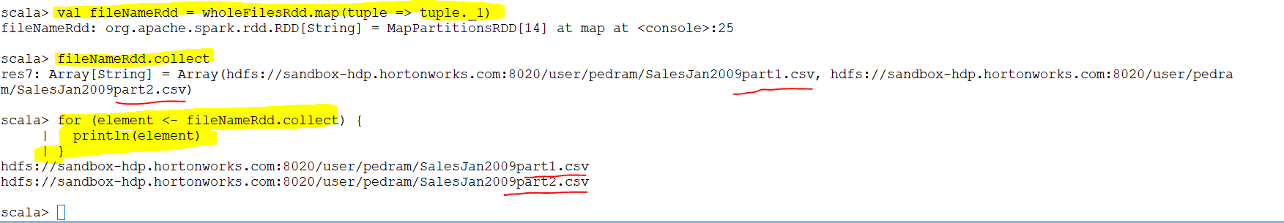
Notes:
wholeTextFile will read whatever files are there under pedram directory
It will run a map operation in each element inside the wholeFileRdd. What is the contents of wholeFileRdd ?This contains some tuples.(String, String)
The first tuple contains the location of the file and entire contents of the first file
The second tuple contains the location of the file and entire contents of the second file
In the second command ( val fileNameRdd ) I do a map operation (take the tuple and returns the first element which is the name of the file) on each element or tuple of wholeFilesRdd and return the first element of that tuple which is file name
fileNameRdd.collect returns an Array so I use for loop
So it will go for each element of that array and print it.
This called pairRdd BECAUSE IT RETURNS A Tuple. The first element of the tuple is a key and the second element is value
================================================================================
val fileNameRdd = wholeFilesRdd.map(tuple => tuple._1)
fileNameRdd.collect
for (element <- fileNameRdd.collect) {
println(element)
|}

Slide 18
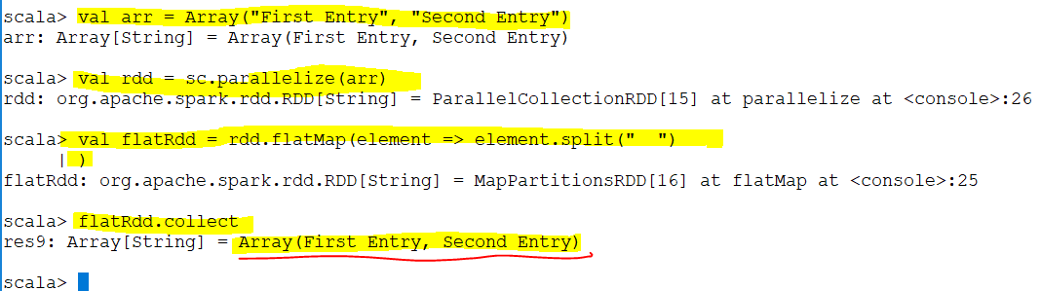
Flatmap :Take the element and returns a collection of elements. Iterate to each element in rdd.It replace the element with collection
Notes:
Arr is an Aarry and it parallelizes in Rdd
Flatmap has now four entry
collect returns the elements of the dataset as an array back to the driver program. collect is often used in previously provided examples such as Spark Transformation Examples in order to show the values of the return.

Slide 19
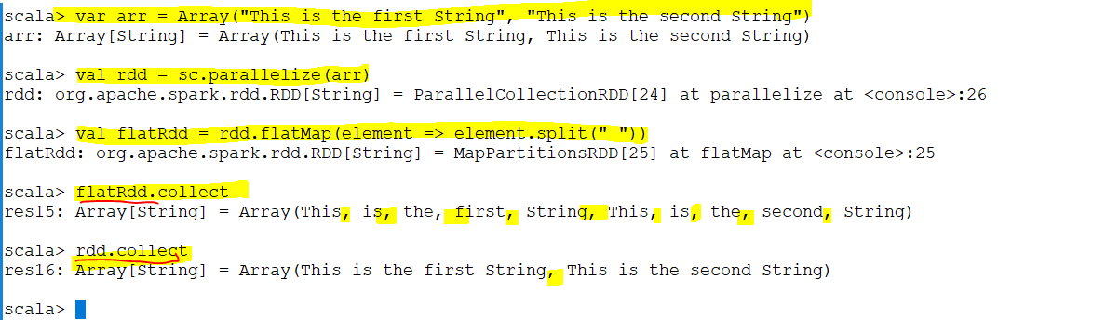

Slide 20
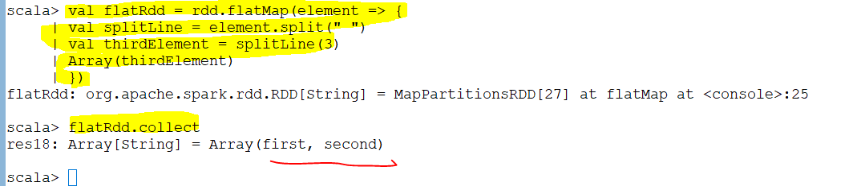
Notes:
The third element from each string will be picked up.I return as array .(remember its like apply)
====================================================
scala> val flatRdd = rdd.flatMap(element => {
| val splitLine = element.split(" ")
| val thirdElement = splitLine(3)
| Array(thirdElement)
| })
flatRdd: org.apache.spark.rdd.RDD[String] = MapPartitionsRDD[27] at flatMap at <console>:25
scala> flatRdd.collect
res18: Array[String] = Array(first, second)

Slide 21
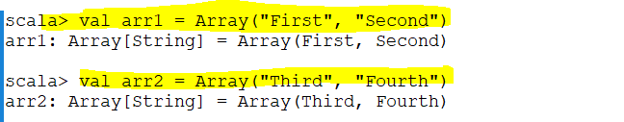
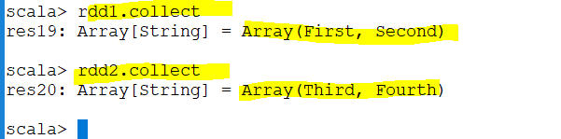
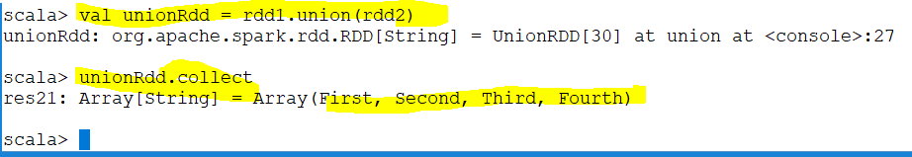

Slide 22
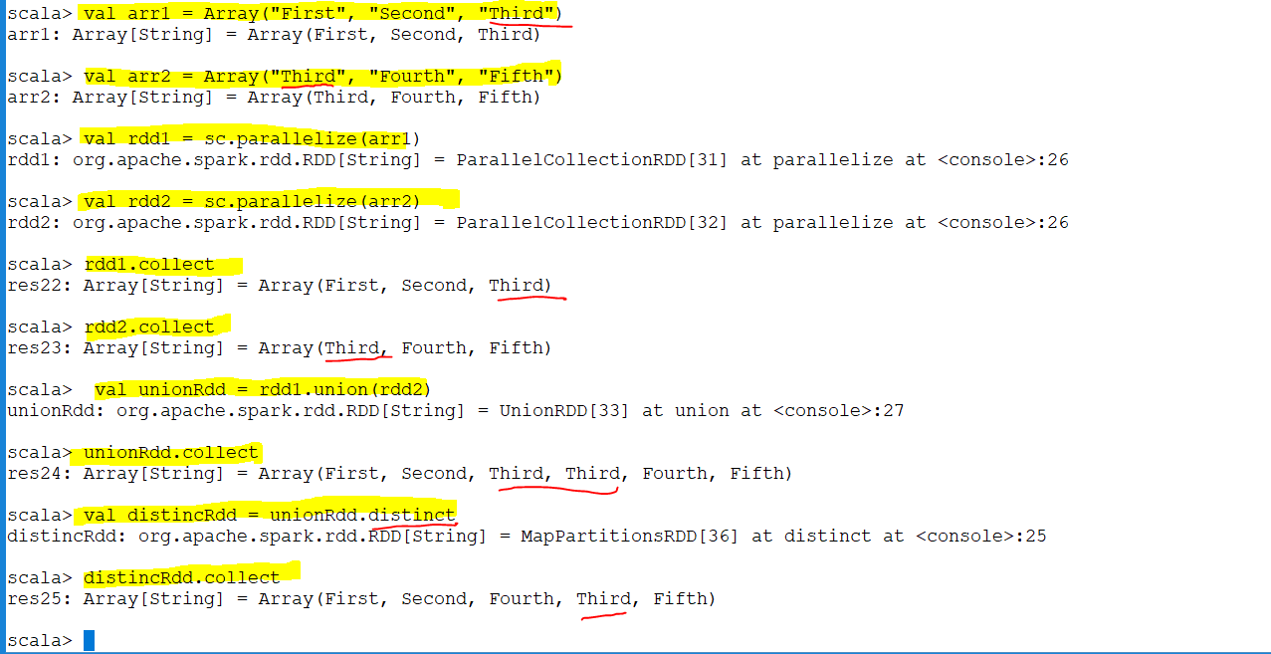

Slide 23
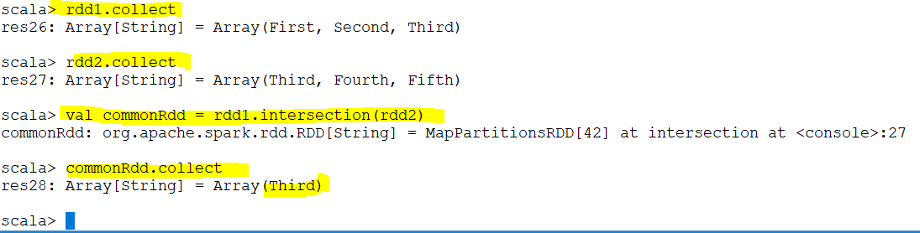

Slide 24
RDD Actions
reduce(func)
collect()
count()
first()
take(n)
takeOrdered(n, [ordering])
saveAsTextFile(path)
saveAsSequenceFile(path)
saveAsObjectFile(path)
foreach(func)
Notes:
Spark never has

Slide 25
PairRDD Actions
reduce(func)
collect()
count()
first()
take(n)
takeOrdered(n, [ordering])
saveAsTextFile(path)
saveAsSequenceFile(path)
saveAsObjectFile(path)
countByKey()
foreach(func)
Its called pairRdd because it returns a Tuple. The first element of the tuple is a key and the second element is value

Slide 26
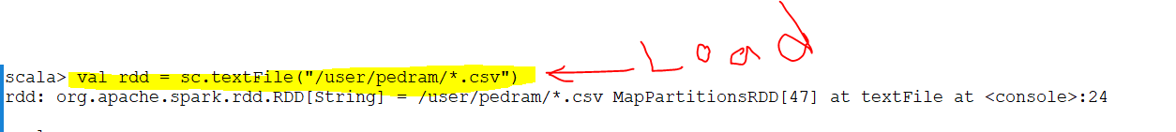
Lazy Evaluation
Load -> Transformation 1 [ -> Transformation 1 -> Transformation 2 -> Transformation 3 -> Transformation 4 -> Transformation 5] -> Action
Example :
Load -> map -> filter -> count
Notes:
[] : optional
It is how it works in spark
Load is where you create your first RDD
I want to get the total Number of sales generated through master card.
Each line in rdd is entire record which is separated by “,” because its csv

Slide 27
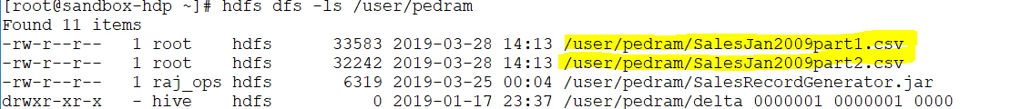
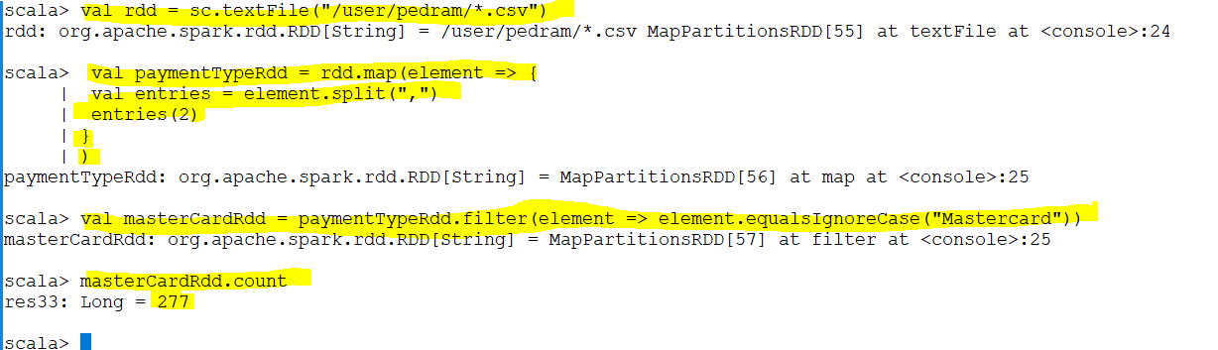
Example :
Load -> map -> filter -> count

Slide 28
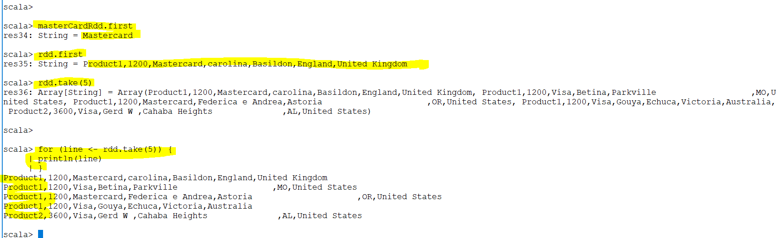
Notes:
It execute a dag because its an action

Slide 29
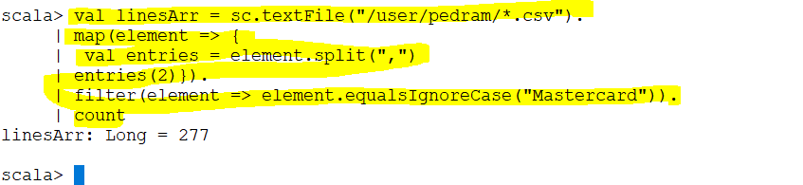
Load
Transformation
Action
Or another way
Notes:
Instead of creating references for each rdd we can do it for all in one line .
I put “.” mean whatever RDD I have do the next transformation
Action
scala> val linesArr = sc.textFile("/user/pedram/*.csv").
| map(element => {
| val entries = element.split(",")
| entries(2)}).
| filter(element => element.equalsIgnoreCase("Mastercard")).
| count
===============================
val linesArr = sc.textFile("/user/pedram/*.csv").filter(element => element.contains("Mastercard")).count

Slide 30
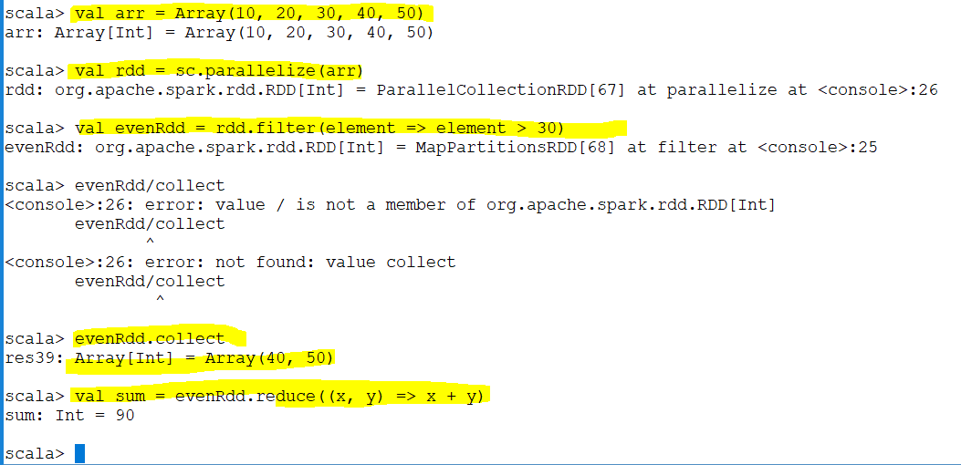
Reduce
Notes:
Reduce first pass

Slide 31
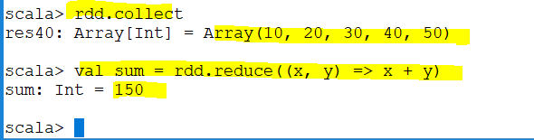
It passes 10 ,20 sum =30
It passes 30 ,30 sum =60
It passes 60 ,40 sum = 100
It passes 100 and 50 sum =150
Notes:
Reduce passes 10 and 20 and add them then consider sum as 30 then pass 30 and 30 which is .,…..
It passes 10 ,20 sum =30
It passes 30 ,30 sum =60
It passes 60 ,40 sum = 100
It passes 100 and 50 sum =150

Slide 32
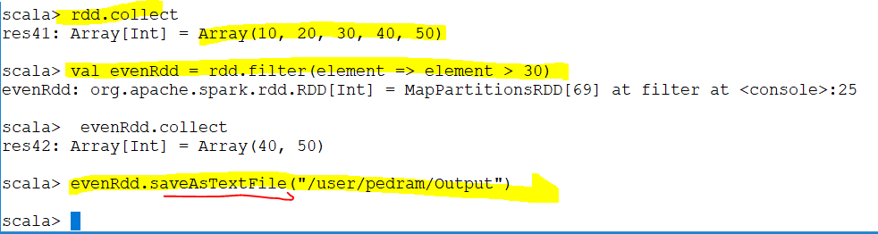
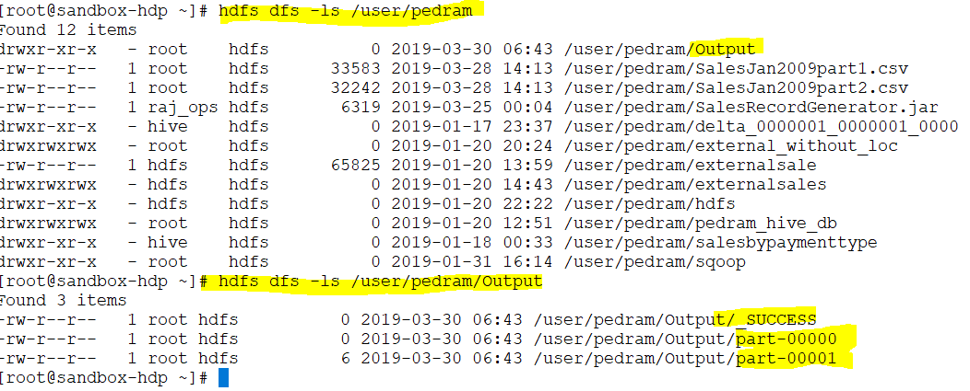
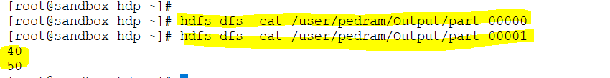
Save
Notes:
When you run saveastextfile “ it will creates a folder called “output”
By looking in to output folder we see there is two files .why ? Because I had two partitions
Save

Slide 33
PairRDD Transformations
filter(func)
map(func)
flatMap(func)
union(otherDataset)
intersection(otherDataset)
distinct([numPartitions]))
groupByKey([numPartitions])
reduceByKey(func, [numPartitions])
sortByKey([ascending], [numPartitions])
join(otherDataset, [numPartitions])
coalesce(numPartitions)
repartition(numPartitions)
repartitionAndSortWithinPartitions(partitioner)
Its called pairRdd because it returns a Tuple. The first element of the tuple is a key and the second element is value
Notes:
In Rdd we have line which is a record.
InThis called pairRdd BECAUSE IT RETURNS A Tuple. The first element of the tuple is a key and the second element is value
pair Rdd we have key and a value like wholetextvalue .the key is file name and the value is the entire content of the file
PairRDD is a tuple which is the first element is the key and the second element is the value

Slide 34
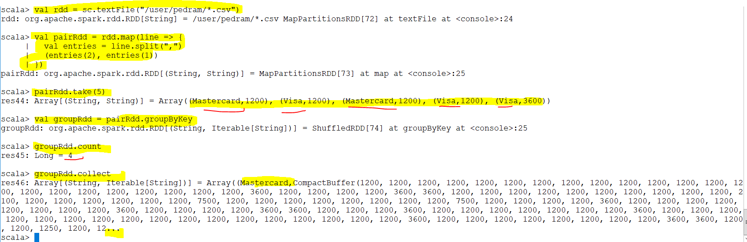
Notes:
PairRDD is a tuple which is the first element is the key and the second element is the value
We have four type of credit card that why it returns 4 .I have grouped them by key so it will return for each card and their value
============================================
scala> val rdd = sc.textFile("/user/pedram/*.csv")
scala> val pairRdd = rdd.map(line => {
| val entries = line.split(",")
| (entries(2), entries(1))
| })
scala> pairRdd.take(5)
scala> val groupRdd = pairRdd.groupByKey
scala> groupRdd.count
groupRdd.collect

Slide 35
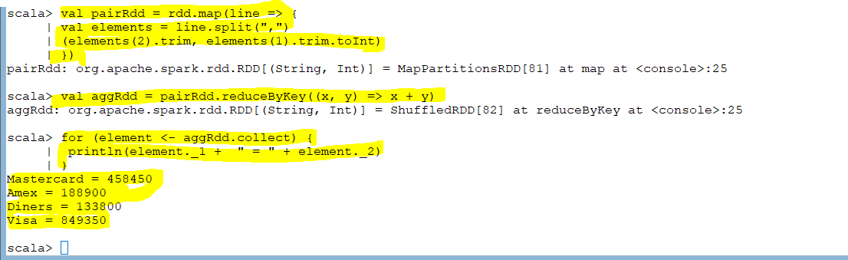
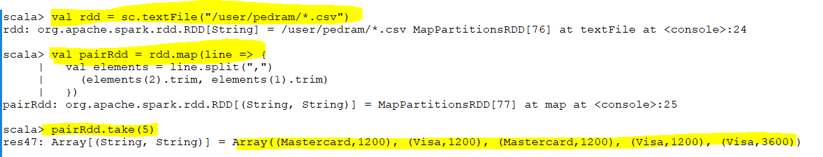
Notes:
val pairRdd = rdd.map(line => {
val elements = line.split(",")
(elements(2).trim, elements(1).trim.toInt)
})
val aggRdd = pairRdd.reduceByKey((x, y) => x + y)
scala> for (element <- aggRdd.collect) {
println(element._1 + " = " + element._2)
}
========================================
Trim : to remove white space
toInt : To change it to Int from string

Slide 36
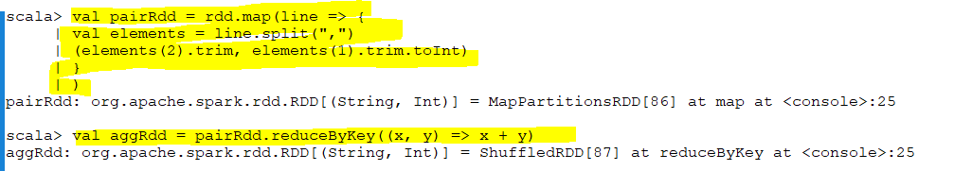
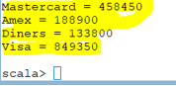
Foreach vs ‘For (collect)’
Notes:
Every Rdd has foreach function .
Foreach acts on each value or line of the partition
For loop does a collect .Spark run on executers which executes the task .
What collect does : is an action .Collect attempt to bring the data from each of the executer to driver and print the value in the driver machine
The following code run on each executer
“rdd.map(line => {
| val entries = line.split(",")
| (entries(2), entries(1)) “
So collect will bring the data to driver and returns the collection from that rdd.
However in foreach does not bring it back to the drive .It will execute the code “aggRdd.foreach(element => println(element._1 + " = " + element._2))” in the executer itself
Collect is slow because data is moved between executer and driver while in foreach is not

Slide 37
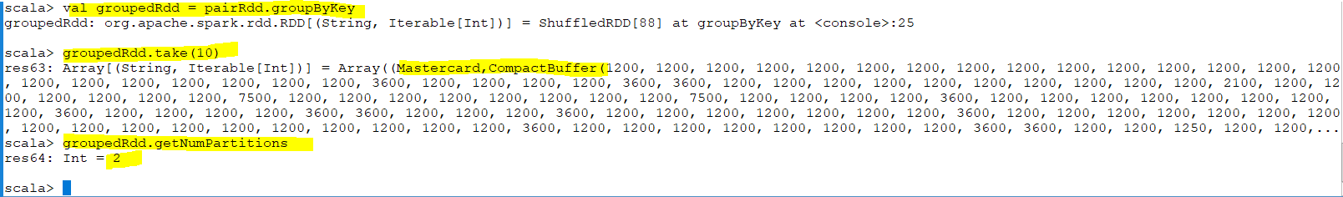
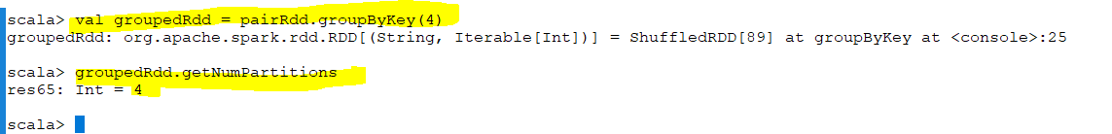
Notes:
All values for master cards are grouped together
If I group you noticed it has two partitions .Master card and visa goes to one partition and Amex , and the forth one goes to the other one.
If I try groupByKey(4) then it will put it in 4 partition. Means instead of putting two card in one partition I put each one in to different parttion so this way my process become faster
==============================
val groupedRdd = pairRdd.groupByKey
groupedRdd.getNumPartitions
val groupedRdd = pairRdd.groupByKey(4)

Slide 38
CountByKey()
generate a count for each record
Notes:
Each

Slide 39
Spark Submit
Locally
Yarn

Slide 40
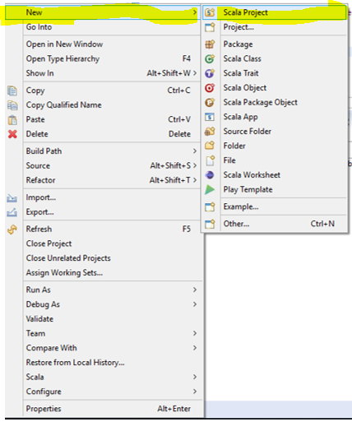

Slide 41
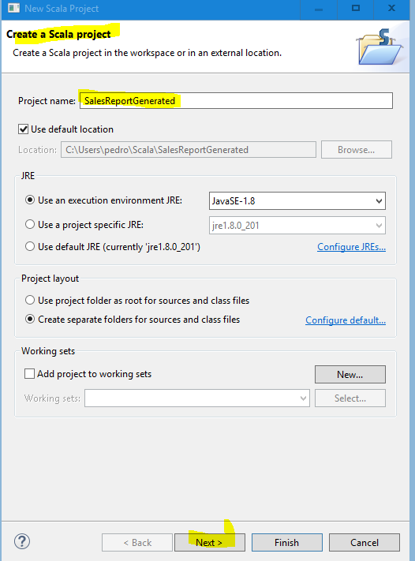

Slide 42
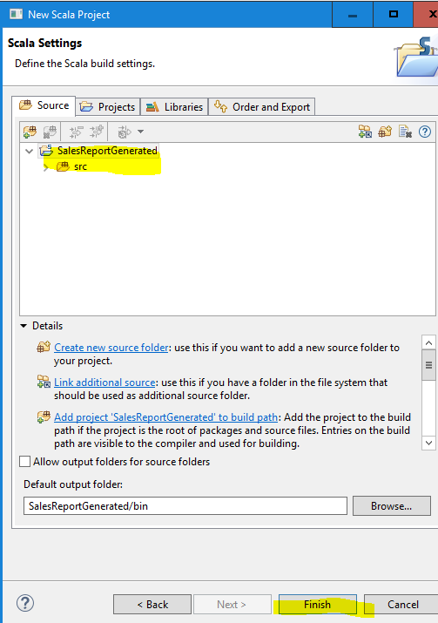

Slide 43
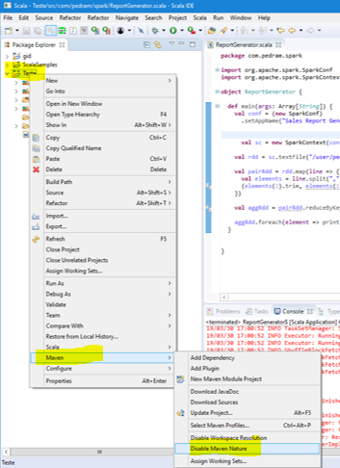
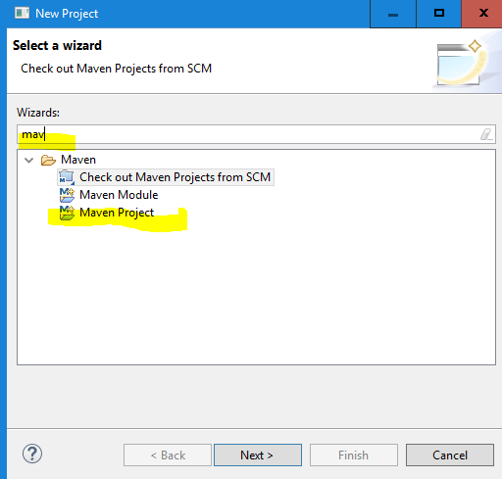
Notes:
If you do not have mavon just enable it. One you enable it ,it becomes Scala and Mavon project
If you do not see Mavon the Right Click– create project -…

Slide 44
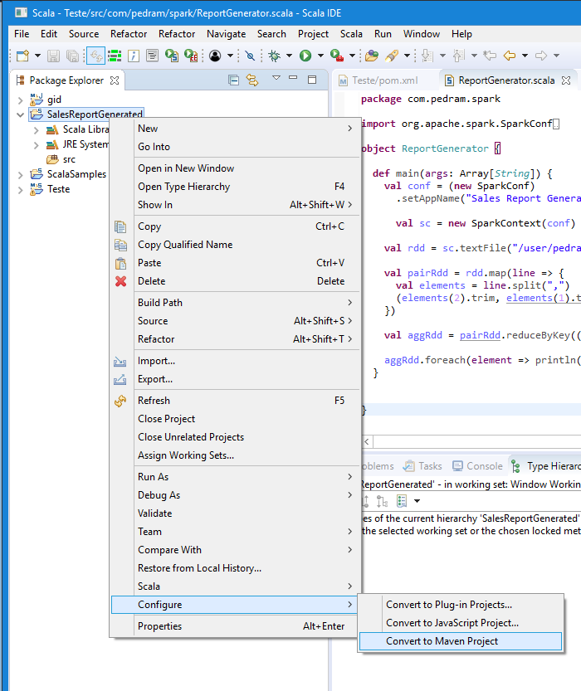

Slide 45
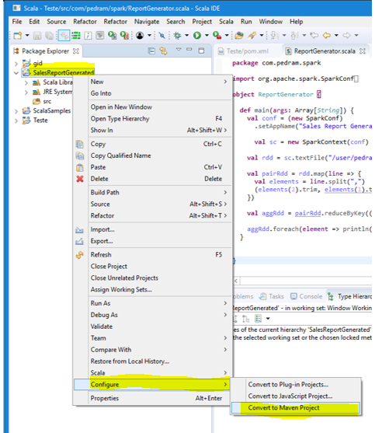

Slide 46
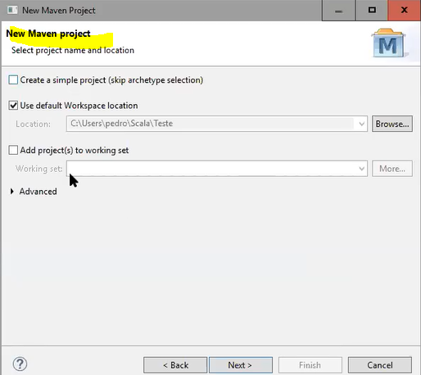
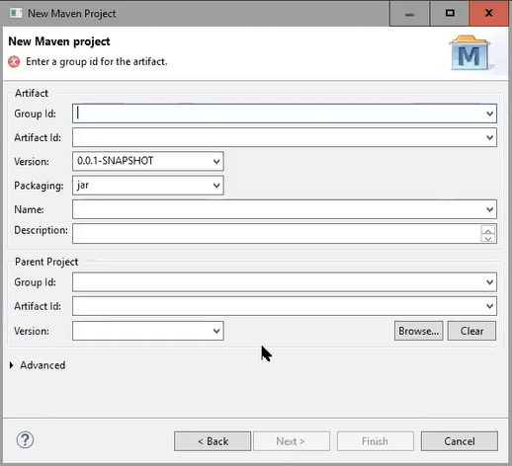
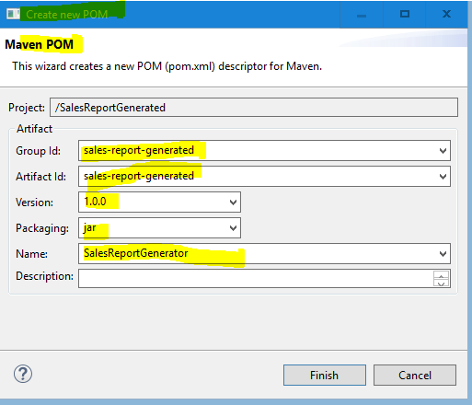

Slide 47
Notes:
Mavon project is Scala or java project but the difference is a Mavon is a build tool .It automatically resolve our dependency
Second it builds my program to jar file

Slide 48

Spark core
Spark SQL
Spark Streaming
Spark Streaming
Notes:
We need dependency because we deal with spark .
Every spark program needs certain libraries
Why this library provided in Moven not in spark-shell .Because the spark-shell has already have library .when we run spark-shell it automatically loads those libraries but the ide does not have it
So we need to copy it to IDE

Slide 49

Notes:
<dependencies>
<dependency>
<groupId>org.apache.spark</groupId>
<artifactId>spark-core_2.11</artifactId>
<version>2.2.0</version>
<scope>provided</scope>
</dependency>
</dependencies>
============
This library will be downloaded .How do we know ? This library has dependency which will e downloaded This is the beauty of Mavon
We do not have to download anything

Slide 50




Slide 51


Scala version of the library

Slide 52



Slide 53



Slide 54


To create SC
Notes:
Sc is spark context
We have to create a spark context because in shell is already created but in my program I need to create
Local[*] : means number of core allocated to your machine .
===================================
import org.apache.spark.SparkConf
import org.apache.spark.SparkContext
object ReportGenerator {
def main(args: Array[String]) {
val conf = (new SparkConf)
.setAppName("Sales Report Generator")
val sc = new SparkContext(conf)
val rdd = sc.textFile("/user/pedram/SalesJan2009.csv")
val pairRdd = rdd.map(line => {
val elements = line.split(",")
(elements(2).trim, elements(1).trim.toInt)
})
val aggRdd = pairRdd.reduceByKey((x, y) => x + y)
aggRdd.foreach(element => println(element._1 + " = " + element._2))
}
}

Slide 55


Slide 56


Notes:
The result is matching with previous commands which we ran
=============================================
val rdd = sc.textFile("/user/pedram/SalesJan2009.csv")
val pairRdd = rdd.map(line => {
val elements = line.split(",")
(elements(2).trim, elements(1).trim.toInt)
}
)
val aggRdd = pairRdd.reduceByKey((x, y) => x + y)
for (element <- aggRdd.collect) {
println(element._1 + " = " + element._2)
}
Mastercard = 458450
Amex = 188900
Diners = 133800
Visa = 849350

Slide 57

If we run it in the cluster then we should not set master (because we set the master when we run the jar file) but if I am running in the IDE we can set the master so I have to remove it and fix the location of my file in hdfs

Slide 58



Slide 59



Slide 60


Notes:
You man Browse in the main class to see if you can get it

Slide 61



Slide 62


Slide 63

Notes:
spark-submit --master local[*] --class com.pedram.spark.ReportGenerator /root/SalesRecordGenerator.jar
Your class name is different than mine

Slide 64


Slide 65


Slide 66


Slide 67


Slide 68


Slide 69


key pair
'AWS - SSH Connections Command Line and Webservices V1.0 -PDF document'
Notes:
key pair

Slide 70


Slide 71


Slide 72


Slide 73


Slide 74

Notes:
Remove Task

Slide 75


Slide 76


Slide 77



Slide 78

Notes:
PuTTY does not natively support the private key format (.pem) generated by Amazon EC2. PuTTY has a tool named PuTTYgen, which can convert keys to the required PuTTY format (.ppk). You must convert your private key into this format (.ppk) before attempting to connect to your instance using PuTTY.
Start PuTTYgen (for example, from the Start menu, click All a. Programs > PuTTY > PuTTYgen).
2. Under Type of key to generate, select SSH-2 RSA
3. Click Load. By default, PuTTYgen displays only files with the extension .ppk. To locate your .pem file, select the option to display files of all types.
4. Select your.pem file for the key pair that you specified when you launch your instance, and then click Open. Click OK to dismiss the confirmation dialog box.
5. Click Save private key to save the key in the format that PuTTY can use. PuTTYgen displays a warning about saving the key without a passphrase. Click Yes.
6. Specify the same name for the key that you used for the key pair (for example, my-keypair). PuTTY automatically adds the. ppk file extension. We used RSA since the Key Generator version is different. \\

Slide 79


Slide 80

Notes:
Connect to YOUR instance using SSH and PuTTY
1. Open PuTTY.exe
2. In the Host Name box, enter either Public DNS or Public IP of our instance.
3. In the Category list, expand SSH.
4. Click Auth (don’t expand it).
5. In the Private Key file for authentication box, browse to the PPK file that you downloaded and double-click it.

Slide 81

Notes:
6. Click Open.
7. Click Yes when prompted to allow a first connection to this remote SSH server. Because you are using a key pair for authentication, you will not be prompted for a password.

Slide 82


Slide 83


Slide 84



Slide 85


Slide 86


Slide 87






Slide 88




Slide 89

Notes:
spark-submit --master yarn --deploy-mode cluster --class com.pedram.spark.ReportGenerator ReportGenerator.jar

Slide 90


Slide 91


Slide 92


Slide 93



Slide 94


Slide 95


Slide 96


Slide 97

NUMBER OF core specifies the number of task which can be run in parallel.
Notes:
NUMBER OF core specifies the number of task which can be run in parallel.
Driver core and driver memory are not significant
How do we decide about number of cores per executers ? Your core define the number of parallelism is achieved.
If our data is large we give sufficient number of core .
Assume we have 10G of data. How the file loaded and how many task is created.
File stored as block and each block is like number of split
(10g *1024 ) /128 = 80 blocks
Number of input splits equals the number of partitions when this statement executes(that rdd will have 80 partitions)

Slide 98


Notes:
spark-submit --master yarn --deploy-mode cluster --num-executors 2 --executor-cores 2 --executor-memory 4G --driver-cores 1 --driver-memory 1G --class com.pedram.spark.ReportGenerator ReportGene
rator.jar

Slide 99


Slide 100

Notes:
Collect apply in driver and foreach apply in executer

Slide 101


Notes:
When I said master my driver was running on one of those slave nodes
But when I said client my driver was running on this machine. (on the machine which you run submit command)

Slide 102


Slide 103


